Slide 1
Causes of BoP Disequilibrium

Slide 2
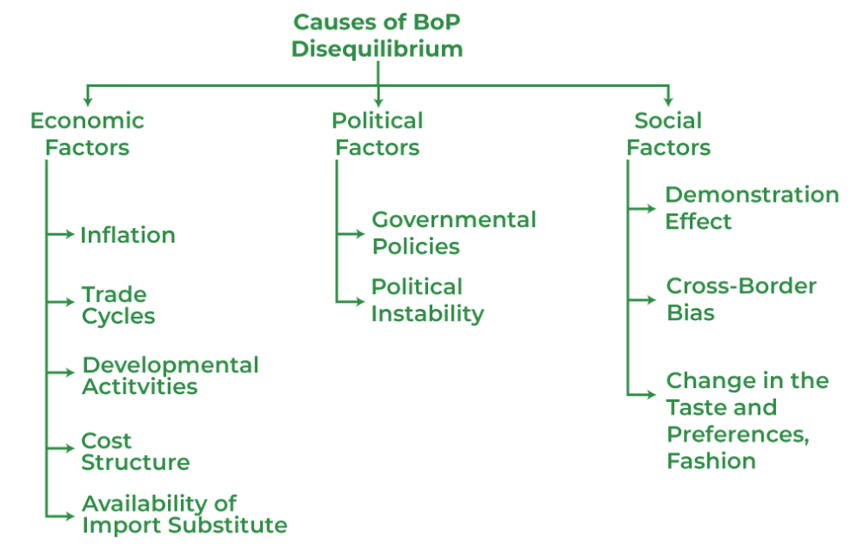
Causes of BoP Disequilibrium

Slide 3
1. Economic Factors
Inflation
Generally, the country's price and cost structure affect the volume of exports and the BoP position. Inflation means a persistent rise in the price of goods and services over a period of time. This increases the cost of living. For example, in the 90s, a movie ticket cost around ₹20, but now the average price is ₹200, thus, it shows a continuous increase in the price. In the context of BoP, it increases the price, due to higher salaries, and higher prices for raw materials, which makes export expensive and imports cheaper; eventually resulting in a BoP deficit.
Trade Cycles
There are four phases in the business/ trade cycle, i.e., Boom, Recession, Depression, and Recovery. Boom and Recovery bring positive changes in the economy; in terms of an increase in the level of investment, income, and production. However, recession and depression bring negative changes to the organization in terms of a decrease in the level of investment, revenue, and production. In the context of BoP; in case of recession or depression, production within boundaries may not be able to accomplish the demand in the domestic market, which eventually leads to the BoP Deficit, due to higher imports. On the other hand, if there is a boom or recovery there is a demand for goods in the foreign market, which increase the export and ultimately leads to a BoP Surplus.
Developmental Activities
Usually, developing countries, like India depend upon developed countries, like the USA for certain imports of goods and services. This leads to an increase in the level of imports, which results in the deficit of the BoP account of developing countries. In case imports fall then the deficit may reduce.

Slide 4
Change in the Cost Structure of the Business Partner
Cost of production plays an important role in deciding whether the country will export its goods and services or not. The company can reduce its cost with the help of the latest technology available in the market. Due to the latest technology, production cost fall, and then the price of the goods and services fall, which leads to a rise in the exports, which results in a BoP Surplus. On the other hand, the domestic cost of production rise, and the price of the goods and services rise, which leads to an increase in the imports which results in a BoP Deficit.
Availability of Import Substitute
Import substitution refers to the blocking of the imported goods in the country so that there is a boost of domestically produced goods in the economy. If the country can develop a substitute, then there will be a BoP Surplus due to lessor imports. But in case, the country can substitute its imports then there will be a BoP Deficit.

Slide 5
2. Political Factors
Government Policies
Policy is the plan of action chosen by the government. The main purpose of making policies is that it provides directions on how things should be done and the reason why it is done. In case government makes policies that favour imports, then there is a BoP Deficit. But in case government makes policies that favour exports, then there will be a BoP Surplus.
Political Instability
It is a situation in which there is an imbalance in the structure of the government. There is a chance of government collapse in a short time. This instability may lead to an increase in the payments, and it will reduce the capital receipts, thus it will initiate a BoP Deficit. However, if the economy is stable, then receipts are more than payments causing a BoP Surplus.

Slide 6
3. Social Factors
Demonstration Effect
It is human nature, that a person is attracted to the things that he/she does not have. Generally, humans observe the action and behaviour of others and try to imitate them. In economics, the demonstration effect means the habit of the individual to consume the things consumed by others. In case Indians want to imitate western culture, then there will be a rise in the imports, which will result in an adverse level of BoP for the country. But if Indians prefer domestically produced goods over foreign goods then there will be a BoP Surplus.
Cross-border Bias
Cross border bias means that a country’s goods are not valued fairly in international markets. Sometimes exports are forced to sell at lower prices because buyers prefer goods from other countries, even when the quality is similar. At the same time, imports may come in at higher prices due to stronger brands or foreign preference. This combination of cheaper exports and expensive imports reduces foreign exchange earnings and increases foreign exchange spending, which creates a Balance of Payments deficit.
Change in the Taste and Preferences
Taste and preference refer to the special liking of one product over another. For example, some people may prefer western clothes while others choose traditional wear. If foreign consumers develop a favourable preference for a country’s goods, exports rise and the country may experience a BoP surplus. But if their preference shifts away from domestic products, exports fall and imports rise, which can result in a BoP deficit.

